Slide 1
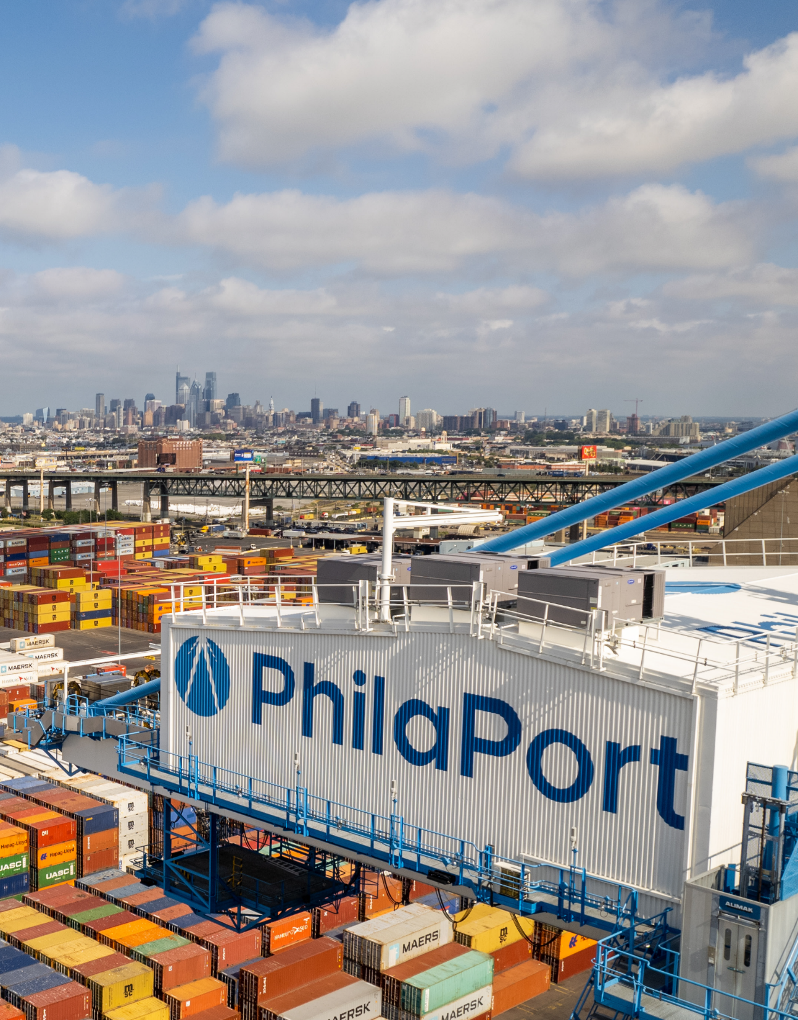




PhilaPort’s Clean Course
Whitman Council Presentation
September 16, 2026

Slide 2
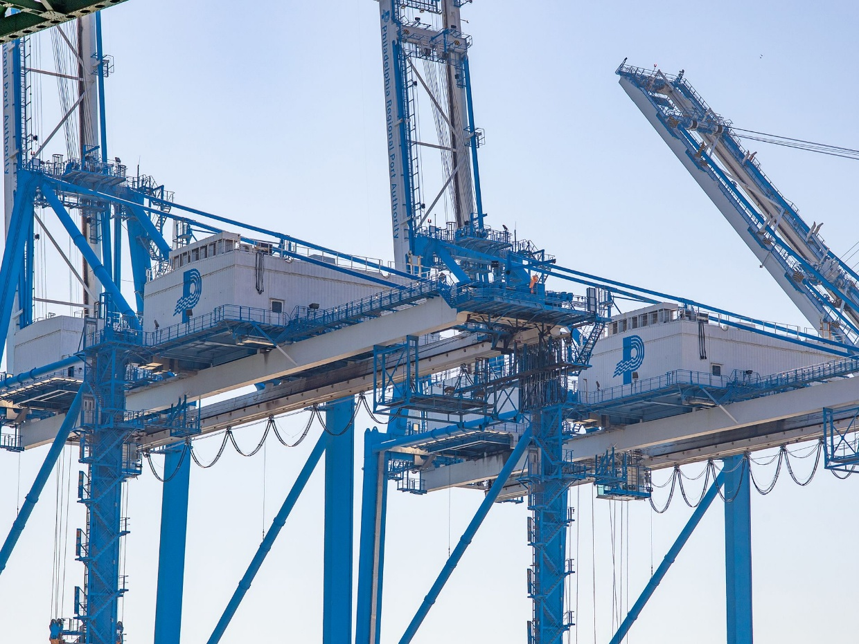
Agenda
PhilaPort Overview
EPA Clean Ports Program Introduction
Recent Zero Emissions Equipment Procurement
Clean Course Planning Framework
Comments and Questions

Slide 3










PhilaPort – The Port of Philadelphia
Total Area
1,100
acres
12,000
Total
Jobs
66,000
Jobs generated from combined Maritime Industry Impact (PA wide)
Major Import
Commodities
Containers
Cocoa
$1.5B
In total economic impact
7.4M
metric tons
Annual cargo throughput in 2024
45-foot Channel Depth
Delaware River Channel
Forest products
Steel/project cargo
Automobiles
Perishables
Over
1,100
Vessel call annually
15
Deep water berths
16,000+
TEUs
Maximum ship size
$320,831,760
total tax impact
3

Slide 4
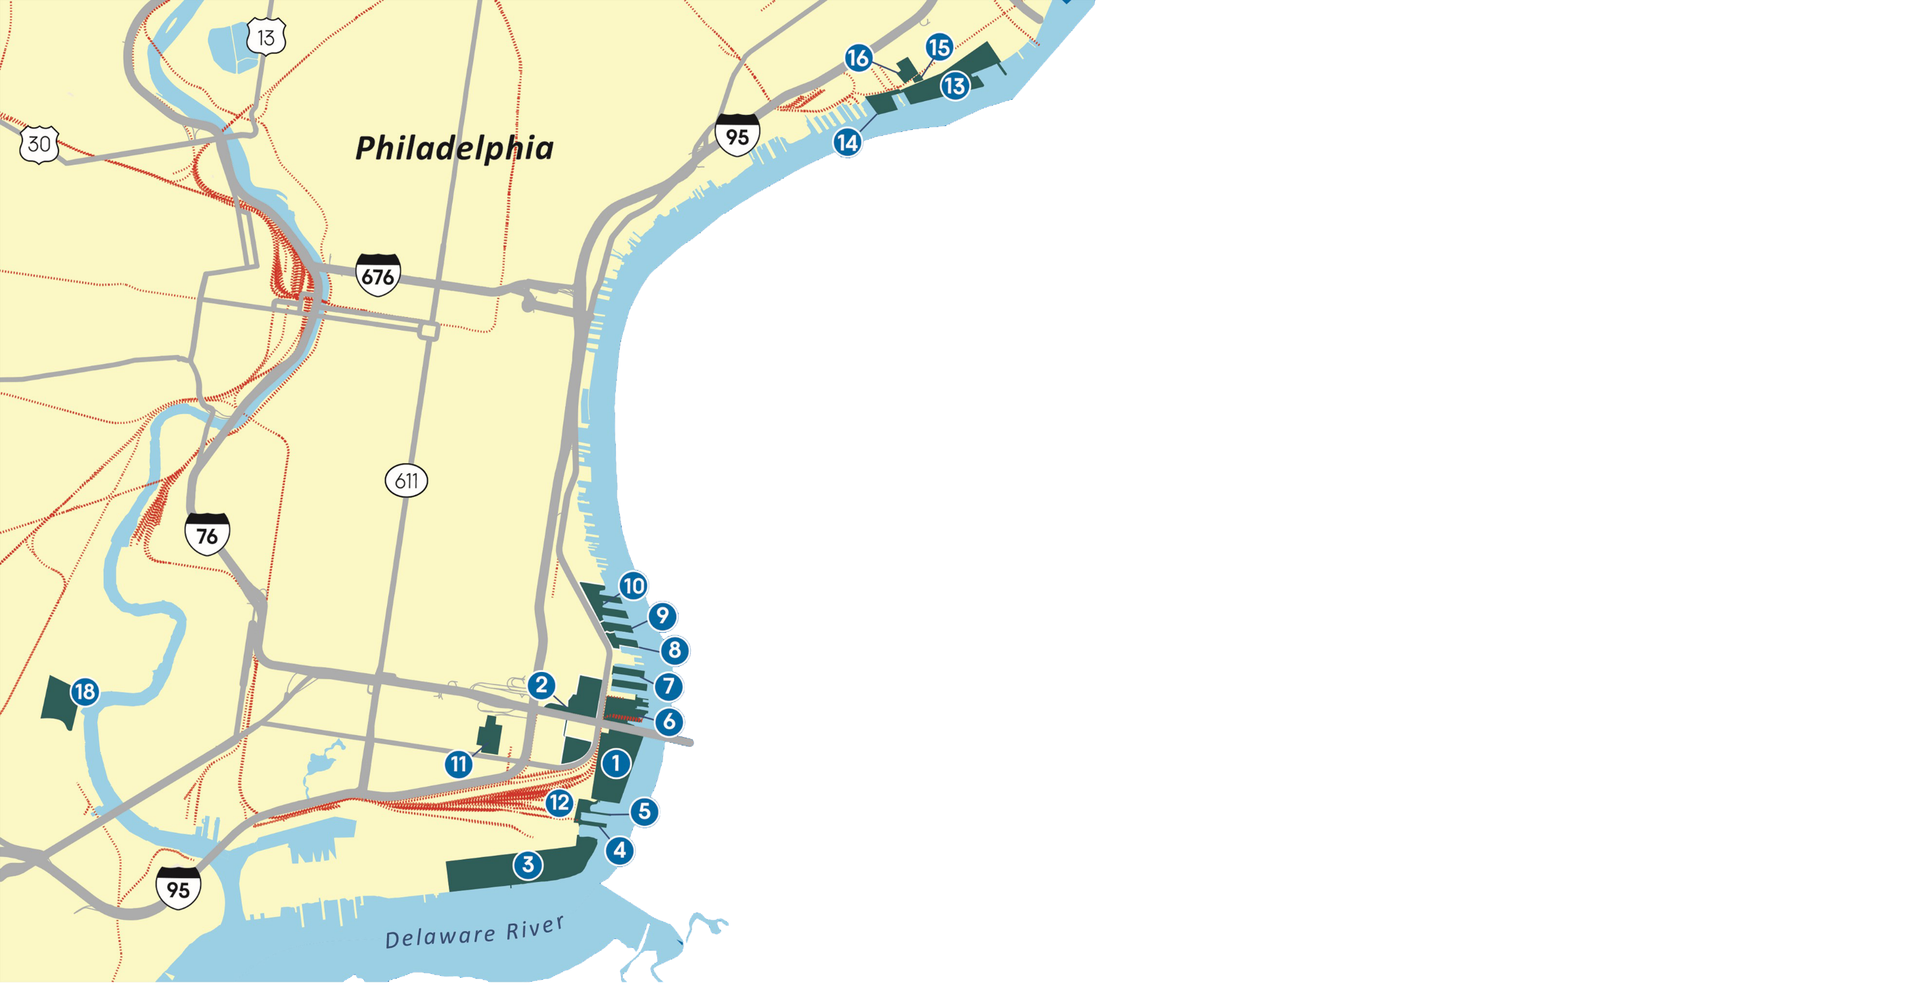
Port Facilities by Commodity
Container Facilities
(1) Packer Avenue Marine Terminal
(6) Packer North
(13) Tioga Marine Terminal
Ro/Ro Facilities
(2) Philadelphia Auto Processing Facility
(3) Southport Auto Terminal
(5) Pier 122
Breakbulk Facilities
(7) Pier 96, 98 & 100
(8) Pier 84
(9) Pier 82
(10) Philadelphia Forest Products Center
*Piers 74 & 78 & 80
(13) Tioga Marine Terminal
Liquid Bulk Facilities
(4) Pier 124
(15) Tioga Liquid Bulk Terminal
Other Properties
(11) PhilaPort Distribution Center
(12) Conrail Loop Track
(15) PhilaPort Main Offices
(16) 3200 E. Tioga
(18) Philadelphia Wholesale
Produce Market
(19) Southport/Mustin Expansion
19

Slide 5

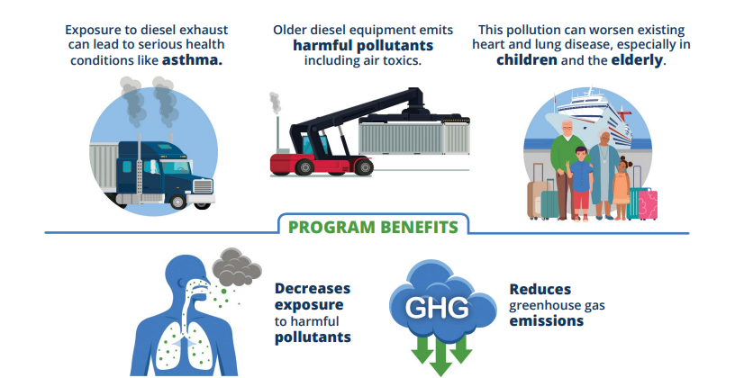
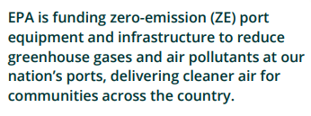
EPA Clean Ports Program
PhilaPort has received $77.9M in grant awards

Slide 6






Chain of Operations
Port operations rely on a connected chain:
from vessels and cranes
rail switches
and warehouses
to yard trucks
trucks

Slide 7
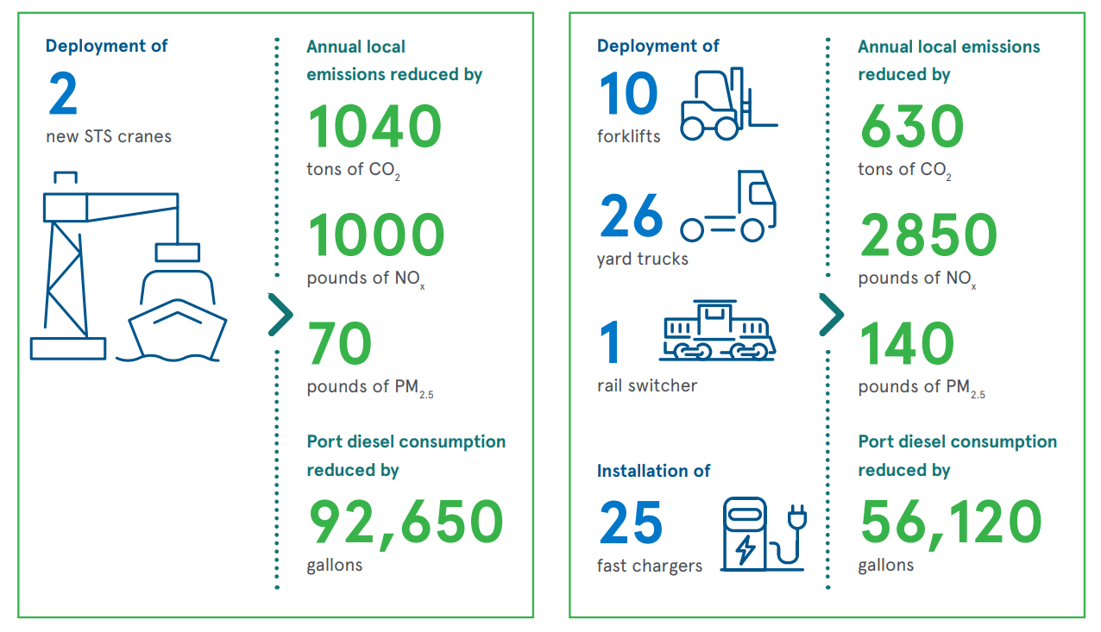
PhilaPort Emissions Reductions
$77.6M to be spent on Zero Emission equipment

Slide 8
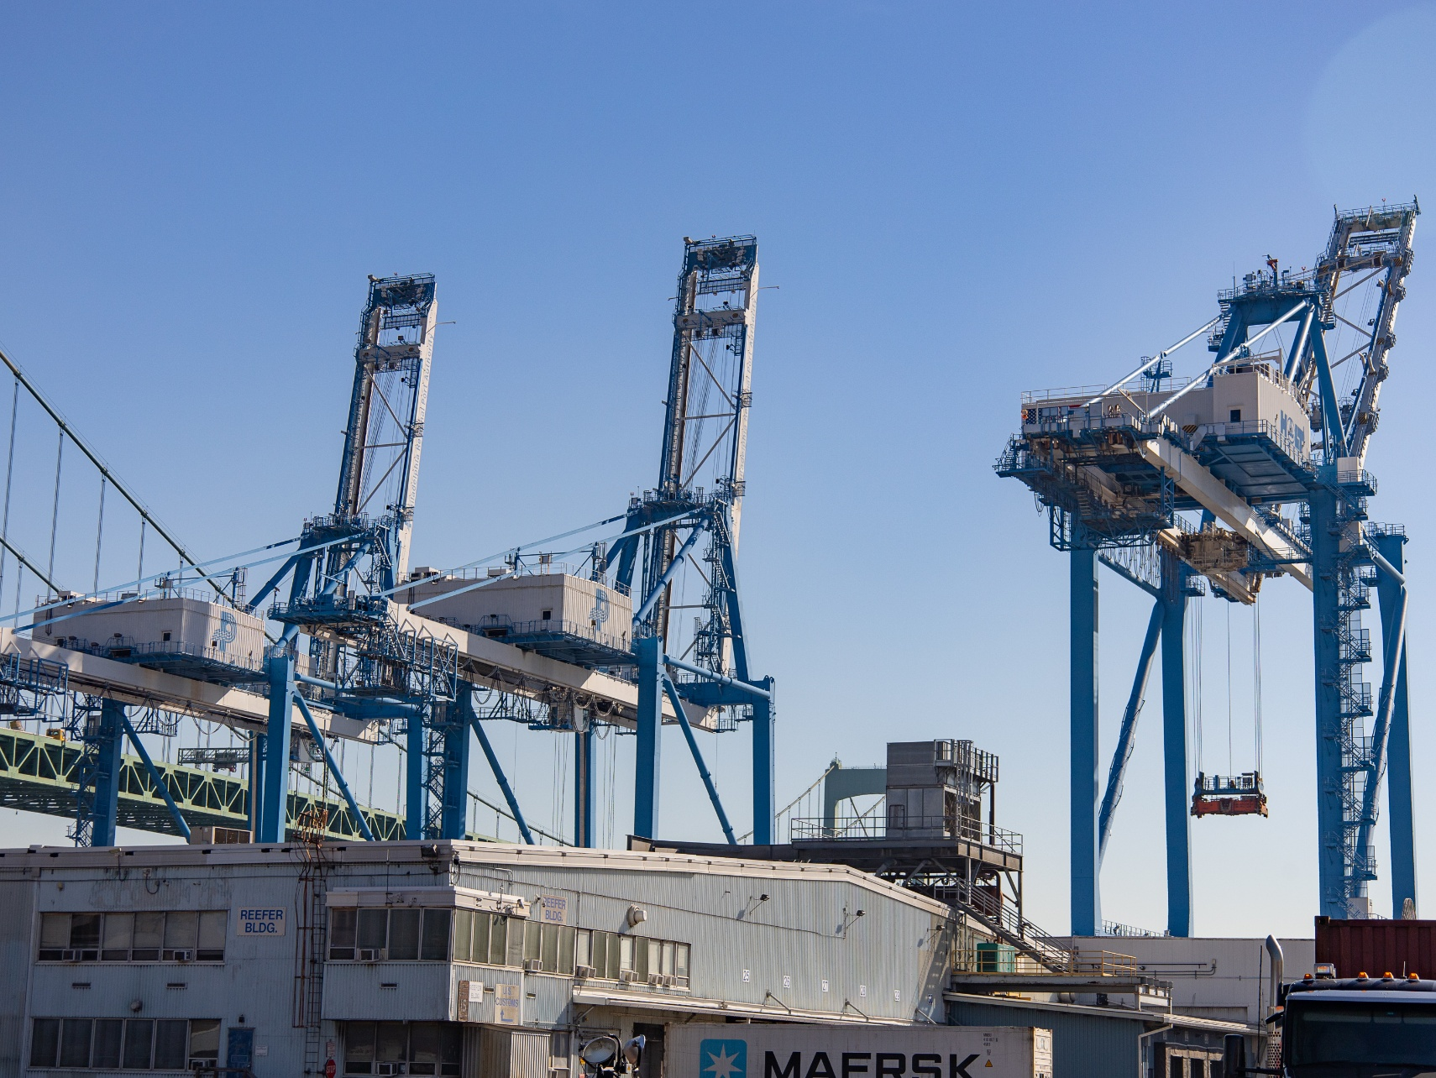
Recent Procurement
7 all electric Ship-to-Shore cranes are in service at Packer Avenue Marine Terminal, replacing diesel equipment and supporting cleaner cargo movement

Slide 9
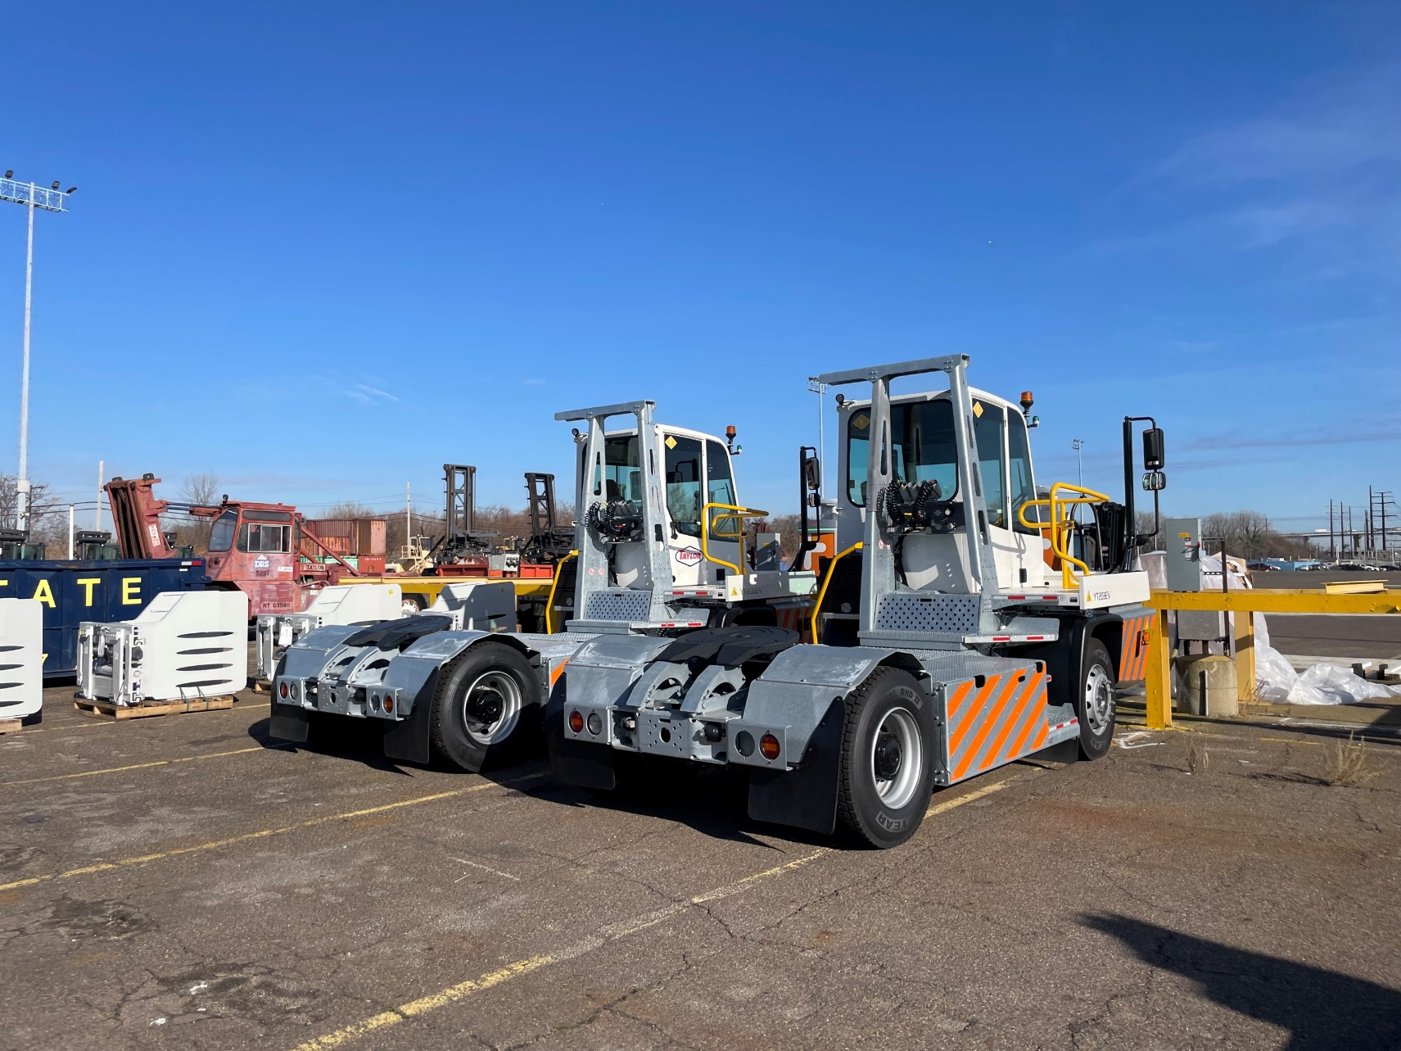
Recent Procurement
4 electric terminal tractors are now operating at Tioga Marine Terminal, helping move cargo more efficiently with zero tailpipe emissions

Slide 10

PhilaPort’s Clean Course
Equipment and Infrastructure Strategy
Community and Stakeholder engagement
Workforce Assessment
PhilaPort’s Clean Course – Navigating to Zero Emissions will create a roadmap to:
Reduce emissions,
Improve air quality, and
Support workforce development

Slide 11
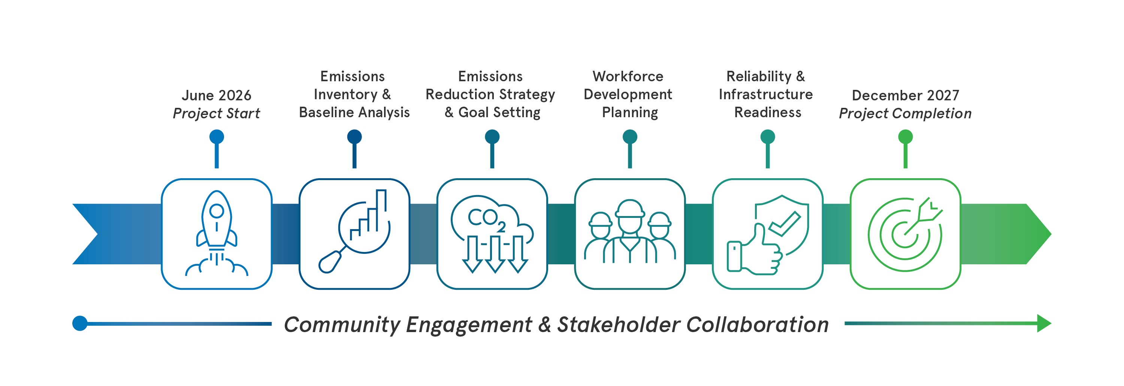
Project Timeline

Slide 12
Understanding Current Conditions
The project began by evaluating existing conditions at the port.
This includes:
Vessel activity and operational patterns
Port equipment and energy usage
Existing electrical infrastructure
Operational and safety considerations
Environmental and regulatory factors

Slide 13
Emissions Reduction Planning
The study will develop a plan for emissions reduction at the port.
Developing an emissions inventory
Emissions reduction planning includes:
Assessing ZE technology feasibility
Determining infrastructure gaps and optimal locations for future ZE investments
Modeling emissions reduction scenarios
Strategizing for net-zero emissions by 2050
The emissions reduction scenarios will inform the final planning report.

Slide 14
Workforce Development
The transition to zero-emission technologies is only possible with a skilled workforce.
Skills required to operate and maintain electric equipment
The study will evaluate:
Training and workforce development needs
Training opportunities and partners
Strategies to support worker retention, upskilling, and recruitment into ZE-related roles
Workforce planning will support job stability and a resilient workforce.

Slide 15
Community Engagement & Stakeholder Collaboration
Stakeholder engagement is a critical part of the planning process.
Port tenants
The project will gather input from:
Public agencies and officials
Utilities and infrastructure partners
Workforce organizations and training programs
Community organizations and environmental groups
Stakeholder insights will help inform the technical analysis and planning recommendations.
The project team will keep stakeholders informed as the project progresses.

Slide 16
Frequently Asked Questions
Which pollutants are being reduced, and what health impacts do they have?
Will the electric grid and charging infrastructure be able to support this transition?
Will this project address emissions from ships?
How will existing jobs be affected under this plan?
Notes:
What pollutants are being reduced, and what health impacts do they have?
Port pollutants include particulate matter (PM), nitrogen oxides (NO_{x}), sulfur oxides (SO_{x}), volatile organic compounds (VOCs) and air toxics.
Exposure to air pollution associated with emissions from diesel engines can contribute to significant health problems—including premature mortality, increased hospital admissions for heart and lung disease, increased cancer risk, and increased respiratory symptoms. Risks are higher especially for children, the elderly, outdoor workers, and other sensitive populations.
Will the electric grid and charging infrastructure be able to support this transition?
Part of this project includes projecting the port’s future energy needs. It will consider where to add chargers on terminals as needed. The project team will also engage with utility providers to make sure there is sufficient capacity.
Will this project address emissions from ships?
Yes, the project will establish the area within a certain radius from the port as the study area. Within the study area, the emissions inventory will capture emissions from vessels at berth, vessels moving in and out of the port, and tugboats.
Will existing jobs be protected under this plan?
The Clean Course project will assess training and workforce development needs to support the transition to zero emission technologies. The Team will gather training opportunities and partners so that workers are equipped operate and maintain electric machines and equipment.

Slide 17
Comments and Questions

Slide 18
Thank you!
Your feedback will help inform this planning project and future recommendations.
Visit https://www.philaport.com/cleancourse/ for more information.

